Slide 1



parSPICE Parallel SPICE Implementation
NASA JPL Team
Notes:
Title page for presentation, first presenter / Project Manager can introduce video but not necessary.

Slide 2


Meet the Team
Austin Albert
Project Manager
Nicholas LaMonica
Developer
Tester
Joel Courtney
Developer
Tester
Willie Chew
Developer
Correspondence
Joseph Ledesma
Developer
QA Manager
Matthew Cohen
Developer
Tester
Sahib Bajwa
Developer
Tester

Slide 4
About NASA JPL
Formed in the 1930’s
Gained US Army sponsorship in 1944
Transferred to NASA in 1958
Managed by Caltech, funded by NASA
Mission is to plan and carry out robotic space and Earth Science missions
Notes:
Section 1 - Austin

Slide 5
The SPICE Library
Developed 1982 - 1983
First official use: Magellan mission to Venus
Idea born out of a need found by CODMAC
Developed by the NAIF under the Planetary Science Division
More about SPICE: naif.jpl.nasa.gov/naif
S - Spacecraft trajectory
P - Planet trajectory
I - Instrument information
C - C-Matrix / Orientation information
E - Events information
Notes:
Section 2 - Nicholas LaMonica

Slide 6
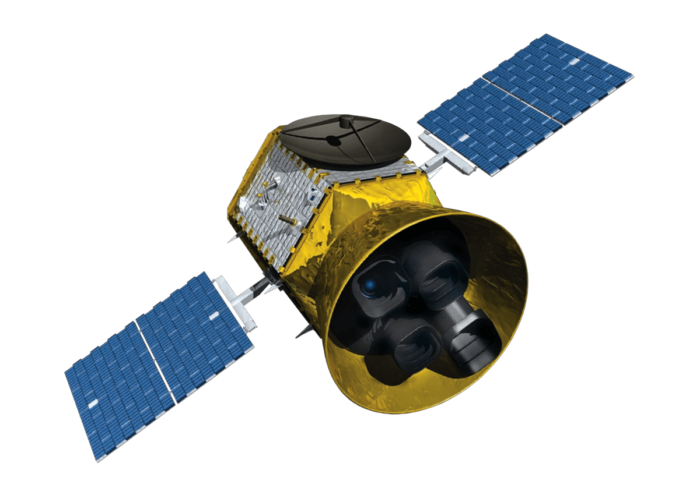

The Need for parSPICE
The SPICE Library is flight-proven and cannot be modified
The current implementation of SPICE cannot take advantage of modern computing resources.
parSPICE will enhance the existing SPICE library with a parallel wrapper
parSPICE will not alter the library functionally in any way
Notes:
Section 3 - Sahib Bajwa

Slide 7
parSPICE Implementation
Objectives of parSPICE:
Create a wrapper library for SPICE Java to support parallel execution of SPICE functions.
The parSPICE library should yield an increase in performance over the implementation currently being used.
Scope of parSPICE:
Replicate all existing SPICE functions and support parallel execution.
Result validation testing of parSPICE.
Performance benchmark tests comparing parSPICE to native SPICE.
Report and Documentation of implementation and use of library.
Notes:
Section 4 - Joseph Ledesma

Slide 8
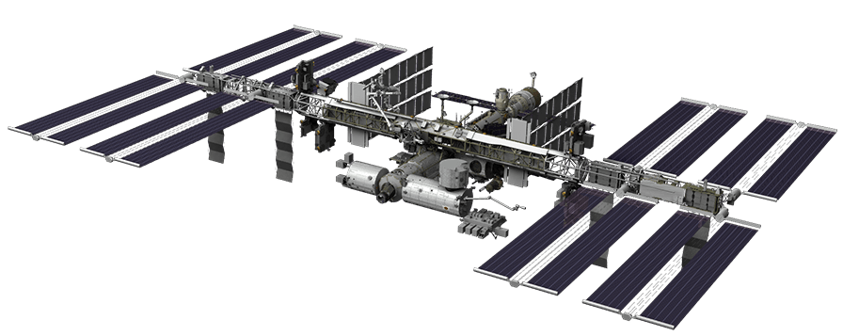
Parallelization Methodology
Candidates for distributing tasks to parallel processors:
ZeroMQ
Asynchronous messaging library.
Initially showed promise until performance issues were discovered.
Performance issues were tied to implementation with Java.
Expansive library with tons of functionality and ability to shape system to needs.
gRPC
Developed by Google.
Used with Google’s Protobuf messages.
Team had some familiarity with system already.
Complicated but provides performance benefits.
Notes:
Section 4 - Joseph Ledesma

Slide 9
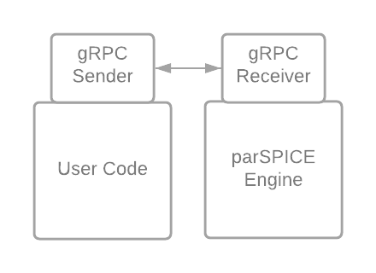
gRPC Messaging Structure
Notes:
Section 5 - Willie
Grpc was chosen as our messaging service since it had the lowest coding overhead
User code and ParSpice engine have

Slide 10
More on our Approach
Test the prototype for performance and accuracy.
Expand prototype to the full SPICE library.
Test parSPICE versus native SPICE Implementation.
Notes:
Section 5 - Willie
Create a prototype solution that works for the sample tutorials provided
Generalize solution and expand to a full library coverage via automation
Test parspice results with normal spice for correctness

Slide 11
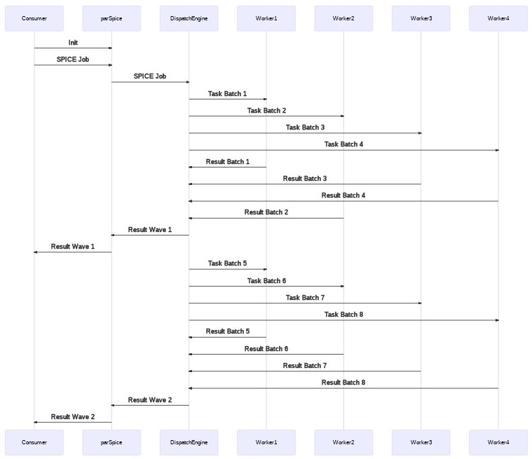
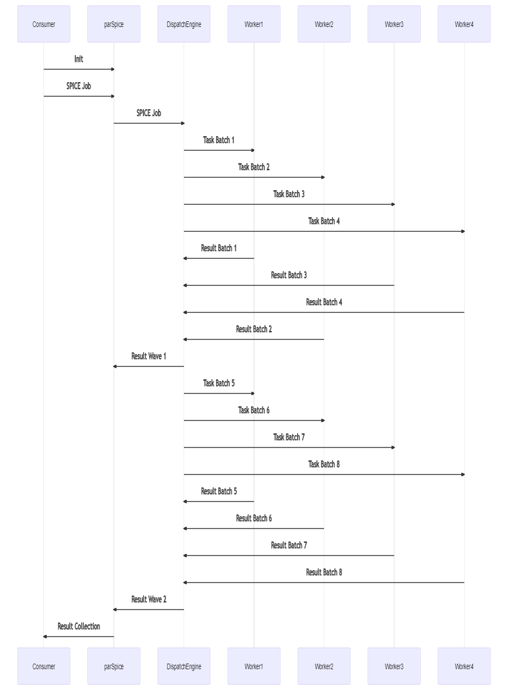
Architecture of parSPICE
Notes:
Section 6 - Joel

Slide 12
Project Deliverables
Parallelization
Strategy Research
Prototype
Testing
Full Solution
Design
Implementation
Testing
Documentation and Report
Implementation
API usage
How and why
Benchmarking results
Notes:
Section 6 - Joel

Slide 13
Fall Semester Plan and Progress
Project Charter
Complete
Requirements Document
Complete
Design Document
In Progress
Benchmark Design
In Progress
Mapping of SPICE Library for parSPICE scope
Complete
Candidate Testing: ZeroMQ vs gRPC
Complete
Design plan for gRPC message dispatching
Complete
Consumer API design plans
Complete
Consumer API consult with sponsor
Complete
parSPICE prototype
In Progress
Notes:
Section 7 - Matt

